Slide 1
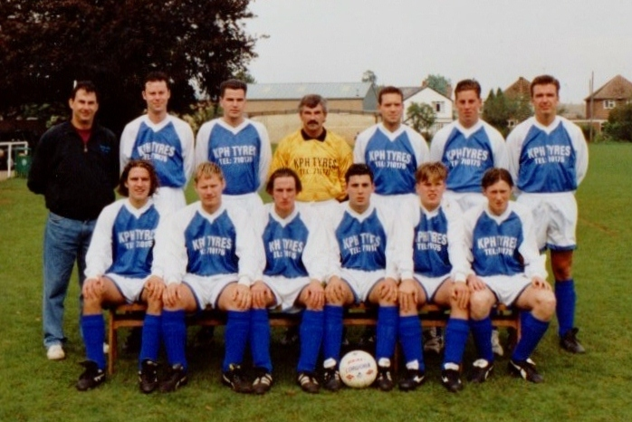
MIDDLETON CHENEY FC 1st TEAM 1993-94
Back Row L/R
Alan Gascoigne ???????? Andy Aston Mick Pond ???????? Graham Shipway ???????????
Front Row L/R
???????? Nigel Smith Steve Thompson Lee Ball Simon Ream Craig Merry

